Slide 1
Final Projects
https://self-supervised.cs.jhu.edu/sp2025/

Slide 2
Overview
20% of your overall grade (proposal, midway presentation, final report and poster)
The objective of the final project is to make use of what you have learned during this course.
You get to pick your problem!
This is your chance to explore a problem with more freedom!
But we give you options.

Slide 3
Group Work
Group work: Students can work in groups (up to 4 people).
Being in a team is encouraged.
If multi-person: Include a brief statement on the work of each teammate
In almost all cases, each team member gets the same score, but we reserve the right to differentiate in egregious cases.

Slide 4
Using Existing Code
It’s okay (and encouraged) to use existing code/resources
Don't re-invent the wheel.
You must document it and give them credit .
You will be graded on your value-add.
Use any language/framework for your project. Though we expect most will use PyTorch.

Slide 5
Mentorship
You have access to the mentorship of the course staff throughout!
You will be aligned with at least one (possibly two) course staff.
I would love to talk to each team, alas there is only one of me …
It’s your 🫵 job to reach out to them to coordinate times, in case office hours do not fit your schedule.

Slide 6
Project Tracks
Default projects consists of a few scoped goals.
Example: Reproducing an existing result with a smaller model or different dataset.
We will release these on Piazza by Thursday.
Custom projects you define your goal, if you feel ambitious!
I encourage most people to go with the “default projects” since they’re scoped.
Do “custom projects” only if you know have a clear target in mind!

Slide 7
Custom Projects
The topic of this project is open-ended.
This project, for example, can focus on
demonstrating systemic limitations of prior work or
suggesting improvements on methods
…
Really, anything!
Must substantively involve human language or Transformers or pre-training!

Slide 8
Project Timeline (Tentative)
Proposal deadline: April 4, via Gradescope
Midway report: April 20, via Gradescope
Final project posters: May 8 (2-5pm).
Final project report: May 8 EOD, via Gradescope

Slide 9
Project Proposals
The project proposal should be a 2-page document..
Outlining your intended plan for the project.

Slide 10
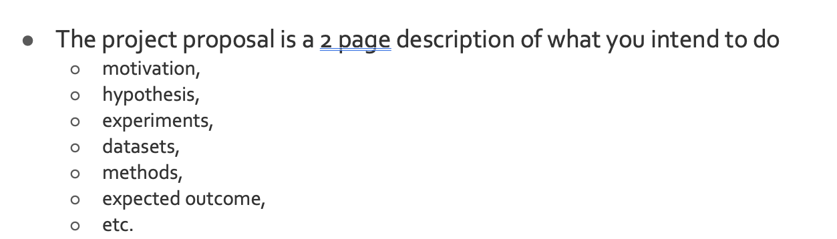
Project Proposals
Make sure that you follow the expected protocol for the proposal.
If you’re missing these details, we will not receive the “proposal” credits and we will ask you to redo it.

Slide 11
Proposals: Be as Precise as You Can
“we will first collect an extensive dataset from various sources such as Google News articles, Reddit discussions, and Twitter conversations.”
What data? What annotations?
“the model will be trained to produce a sentiment indicator that ranges from -10 to 10 …”
What model?
Where did we get these labels?
You want to be as clear and as specific as possible.

Slide 12
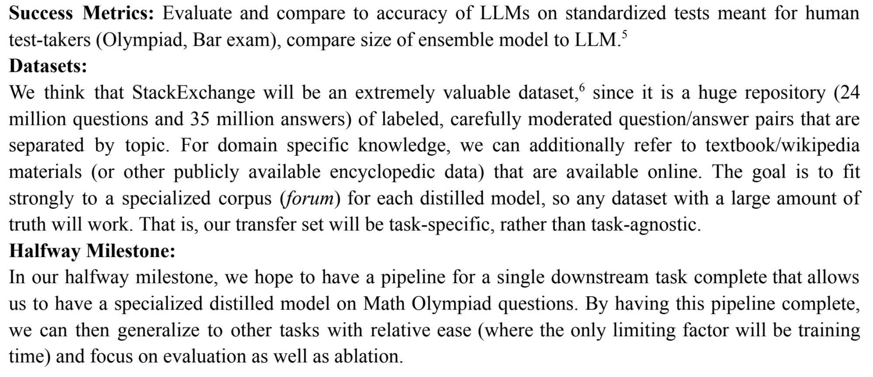
Proposal: An Example

Slide 13
Timeline: Midway Report
This is a progress report — max 5 pages, via Gradescope.
Describe the progress made thus far.
Should be more than halfway done! You’re expected to have some experimental results to show by this date.
The report should outline how you plan to spend the rest of your time.

Slide 14
Final Report
The final report should summarize what you did and your findings (max 8 pages).
Writeup quality is very important for your grade!
See course page for an example of a strong report.

Slide 15
Final Poster
All students will present their findings at a poster presentation during the final exam period.
Then we will celebrate! 🎉
Best Project Awards !
Selected by course staff
Popular vote by the class
Awards details are TBD

